Slide 1
Protein Structure and Energy Landscape Dependence on Sequence using a Continuous Energy Function
Ken A. Dill, Andrew T. Phillips, J. Ben Rosen,
Journal of Computational Biology, 1997, pp.227-239.
Presenter : Hsiao-Yen Chang
Date : October 31, 2007

Slide 2
Abstract
We have recently described a new conformational search strategy
for protein folding algorithms, called the CGU method. Here we use a
simplified protein chain representation and a differentiable form of the
Sun/Thomas/Dill energy function to test the CGU method. Standard
search methods, such as Monte Carlo and molecular dynamics are
slowed by kinetic traps. That is, the computer time depends more
strongly on the shape of the energy landscape than on the number of
degrees of freedom. The CGU method is not subject to this limitation,
since it explores the underside of the energy landscape, not the top.
We find that the CGU computer time is largely independent of the
monomer sequence, for different chain folds, and scales as O(n⁴) with
chain length. By using different starting points, we show that the
method appears to find global minima. Since we can currently find
stable states of 36-residue chains in 2.4 hours, the method may be
practical for small proteins.

Slide 3
Input & output
Purpose:
The purpose of this paper is to show how one can apply
more efficient continuous minimization techniques to the
energy minimization problem by using an accurate
continuous approximation to the discrete information
provided for known protein structures.
Input:
The polypeptide model and the potential energy function.
Output:
The global minimum of the polypeptide’s potential energy function.

Slide 4
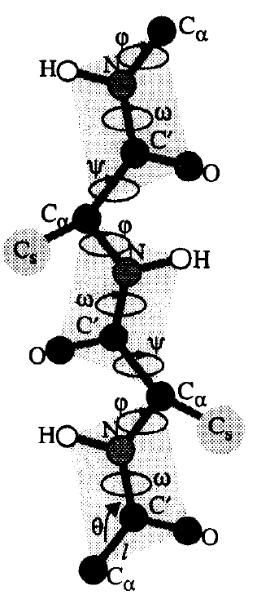
The Polypeptide Model
The 3n-1 backbone bond lengths ﺎ between the pairs of consecutive atoms N – C, C – C_{α}
and C_{α} – N.
The 3n-2 backbone bond angles θ defined by
N – C_{α} – C, C_{α} – C – N, and C – N – C_{α}.
The n-1 peptide bond dihedral angles ω.
The n-1 backbone dihedral angle pairs (φ,Ψ).
Each sidechain is classified as either hydrophobic (H)
or polar (P), and is represented by only a single
‘virtual’ center of mass atom (C_{S}).

Slide 5
The Potential Energy Function (1/7)
the Sun/Thomas/Dill energy function and has the following form:
E _{total} = E_{ex} + E_{hp} + E_{hb} + E_{φΨ}
where E_{ex} is the steric repulsive term which rejects any conformation that would permit unreasonably small interatomic distances, E_{hp} is the contact energy term favoring pairwise H-H residues, E_{hb} is the contact energy term favoring pairwise hydrogen bonding, and E_{φΨ} is the main chain torsional term that allows only those (φ,Ψ) pairs which are permitted by the Ramachandran maps.

Slide 6
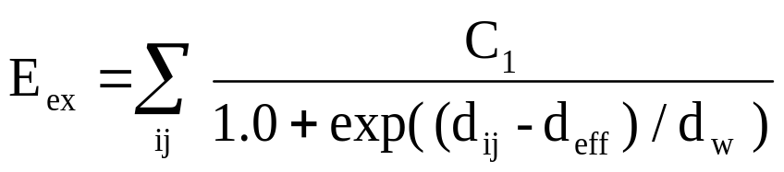
The Potential Energy Function (2/7)
where d_{ij} is the interatomic distance between two C_{α} atoms or between two sidechain center of mass atoms C_{S}, d_{w} determines the rate of decrease of E_{ex}, and d_{eff} determines the midpoint of the function.

Slide 7
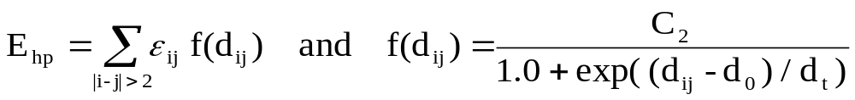
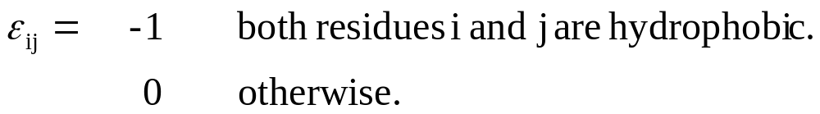
The Potential Energy Function (3/7)
where d_{ij} represents the interatomic distance between two sidechain centroids C_{S}, and d₀ and d_{t} represent the rate of decrease and the midpoint of E_{hp}, respectively.

Slide 8
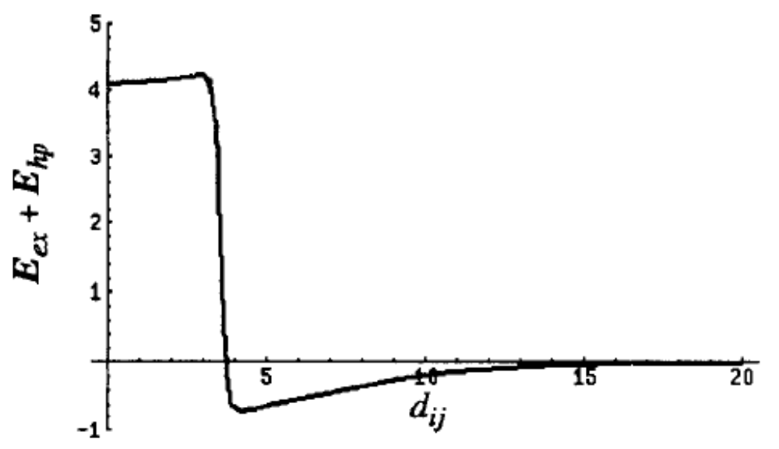
The Potential Energy Function (4/7)
Figure 2 shows the combined effect of the energy terms E_{ex} + E_{hp} for a pair of H-H residues.

Slide 9
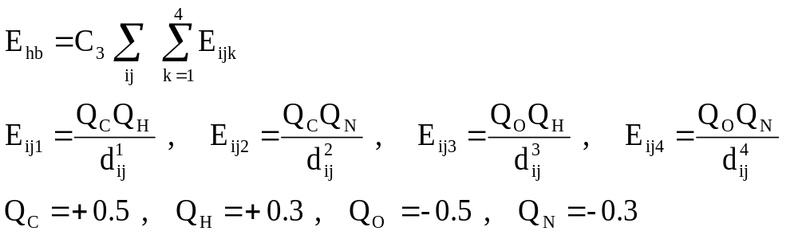
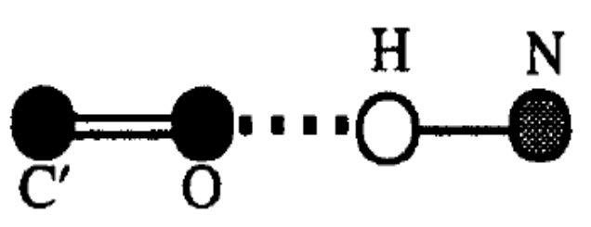
The Potential Energy Function (5/7)
d⁴
d³
The energies between the pairs C/H and O/N are repulsive while the energies between C/N and O/H are attractive.
d²
d¹

Slide 10
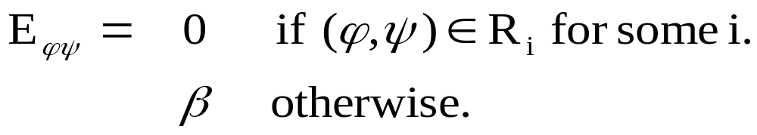
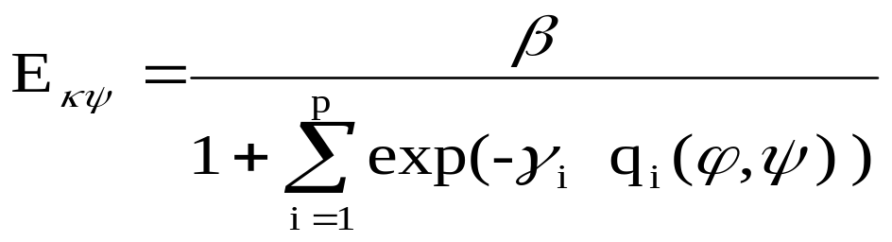
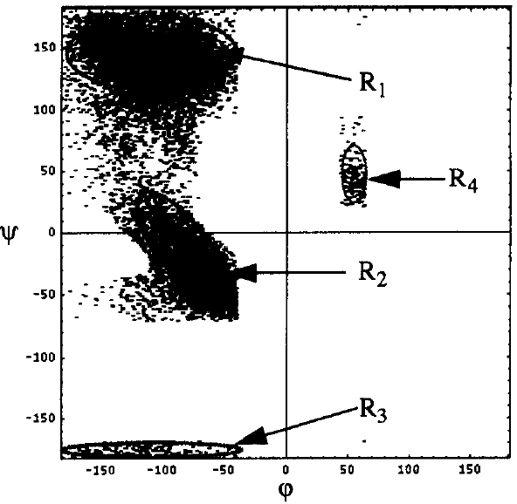
The Potential Energy Function (6/7)
q_{i}(φ,Ψ) = 0 on the boundary of R_{i}.
q_{i}(φ,Ψ) < 0 in the interior of R_{i}.
q_{i}(φ,Ψ) > 0 in the exterior of R_{i}.
Typical Ramachandran Plot

Slide 11
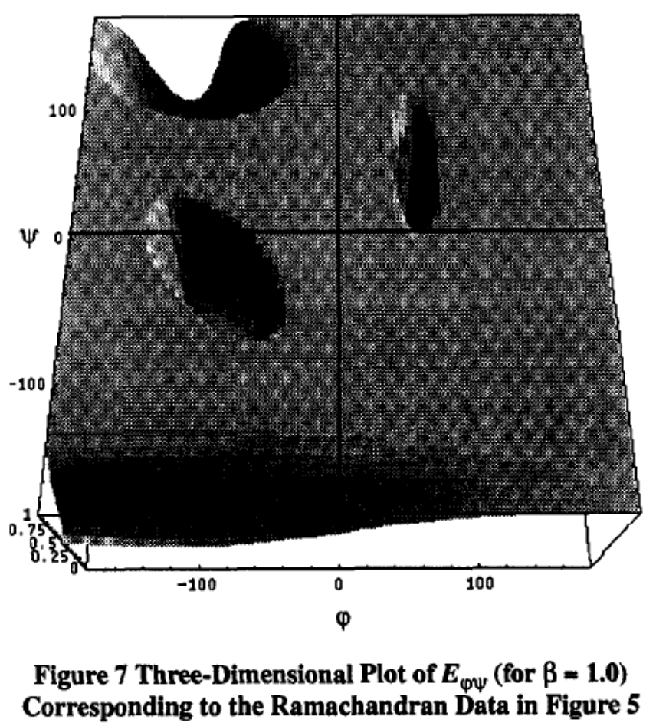
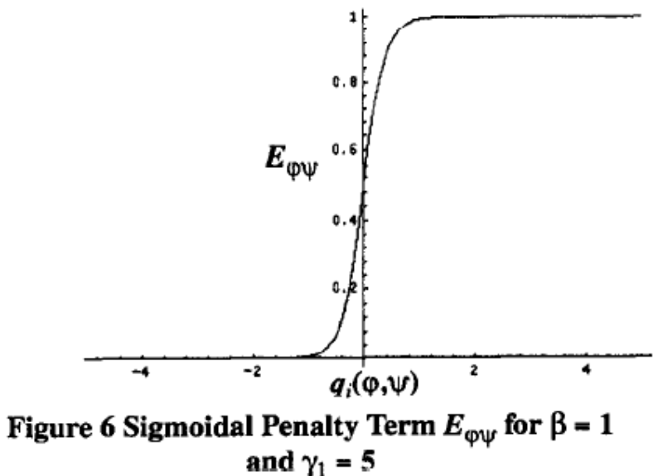
The Potential Energy Function (7/7)

Slide 12
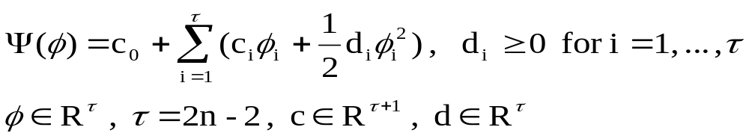
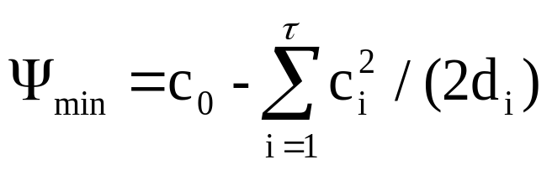
The CGU Global Optimization Algorithm
CGU (convex global underestimator)

Slide 13
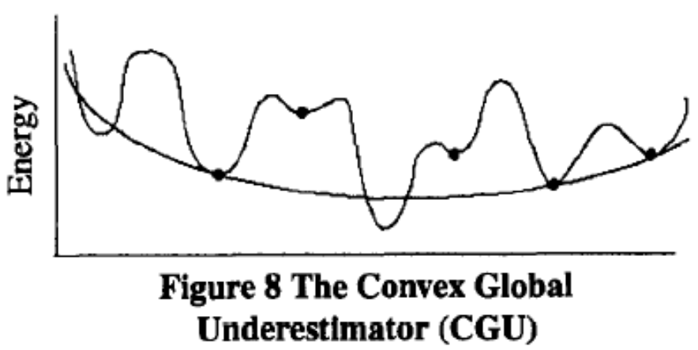
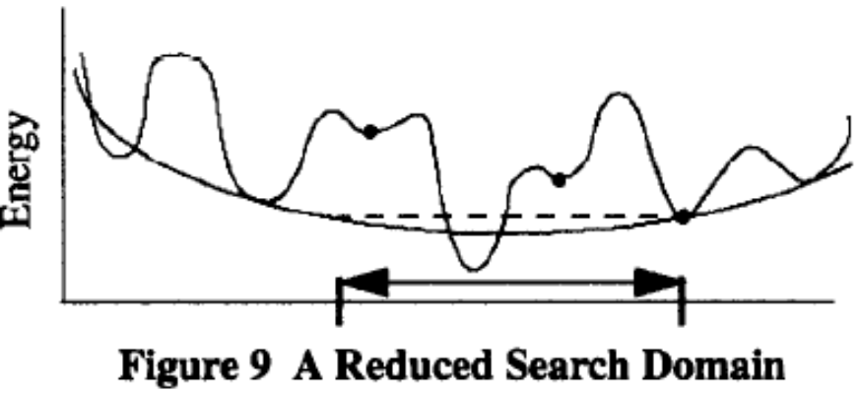
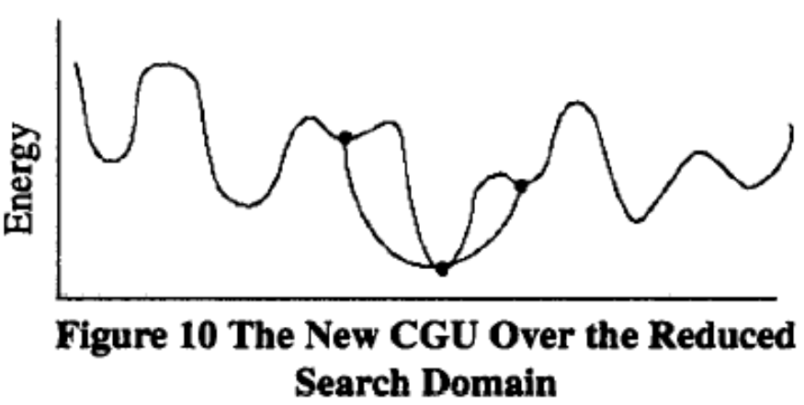
The CGU Global Optimization Algorithm

Slide 14
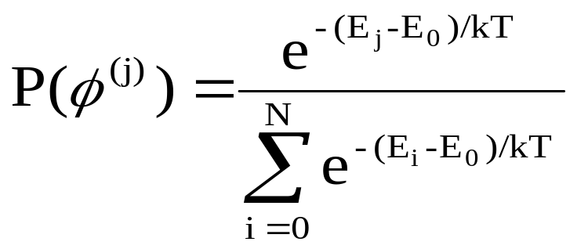

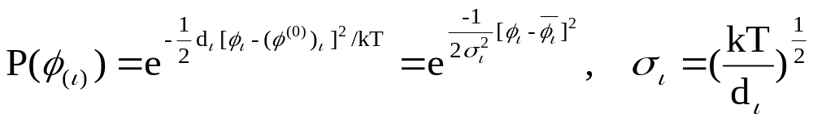
The Native Structure and Its Fluctuations
The probability P(Ф^{(j)}) of finding a molecule in a conformation Ф^{(j)} is given by the Boltzmann distribution law

Slide 15
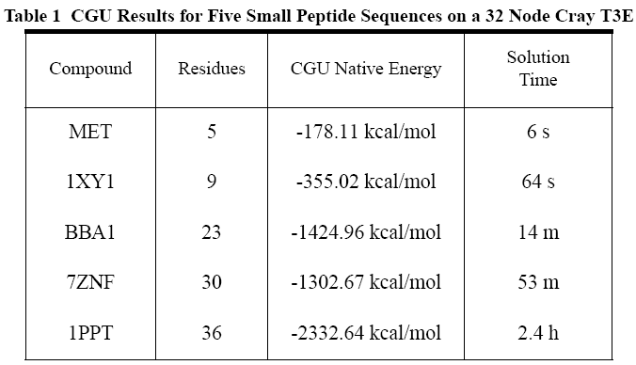
Result

Slide 16
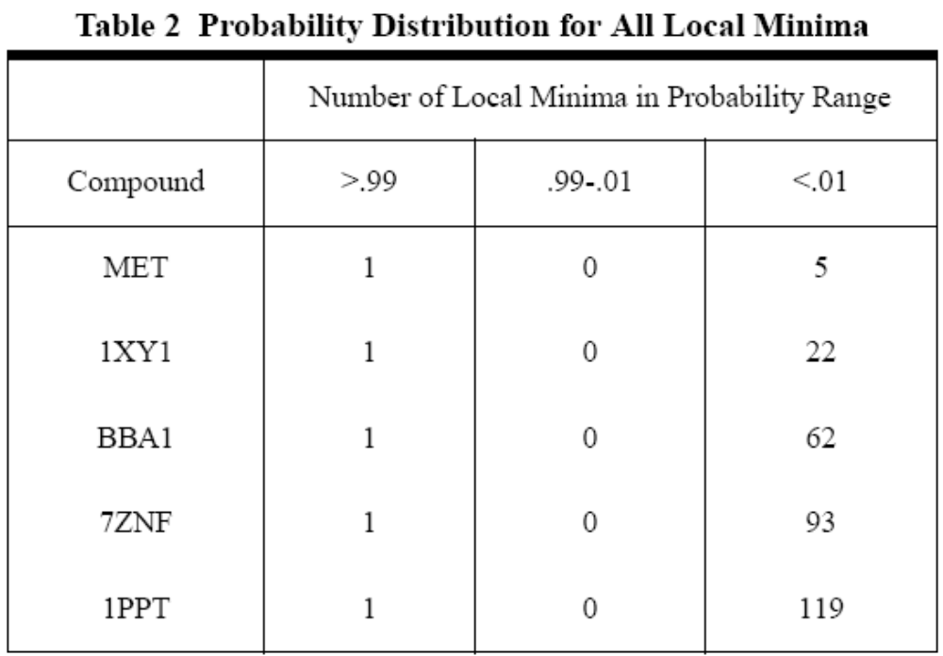
Result

